Slide 1
SHADING

Slide 2
ILLUMINATION MODEL

Slide 3
CONTENTS
Introduction
Definition
Working
Applications
Disadvantages

Slide 4
INTRODUCTION
Color is a fundamental attribute of our viewing experience. The perception of color arises from light energy entering our visual system.
This complex process is relevant to computer graphics because a realistic image is one that seems indistinguishable from the light energy coming from a real scene.
We use a well-known formula to mimic the effect of objects being lit by light sources and we describe several useful techniques for shading polygon-mesh objects.

Slide 5
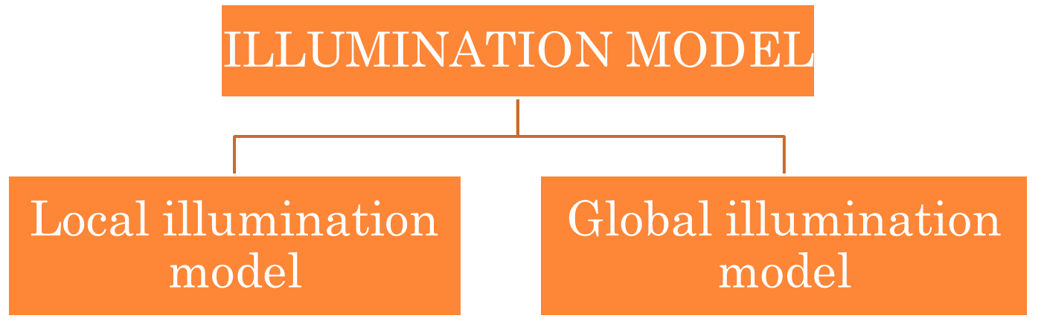
DEFINITION
ILLUMINATION MODEL can be defined as a model used in computer graphics to show reflection on objects.

Slide 6
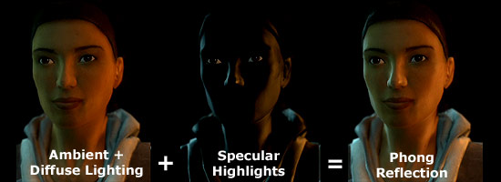
LOCAL ILLUMINATION MODEL OR THE PHONG MODEL
The Phong Model is also referred to as Local Illumination Model because its main focus is on the direct impact of the light coming from the light source.

Slide 7
WORKING
Two extreme cases of light reflection are:
Diffuse Reflection – In this case light energy from the light source gets bounced off equally in all directions. Smaller the angle higher the reflection.
Specular Reflection – Since a perfect mirror is nonexistent we want to distribute reflected energy across a small cone-shaped space centered around R, with the reflection being the strongest along the direction of R and decreasing quickly.

Slide 8
INTRODUCTION
Shading is an important part of creating realistic objects.
Illumination may fall unevenly across a polygon.
Can be calculated individually for each pixel.
Expensive to calculate.
Faster shading algorithms exist.

Slide 9
SHADING
There are several key determinants in the level of shading across a polygon.
Surface properties
Texture
Colour
Material
Light sources
Relative positions and orientations

Slide 10
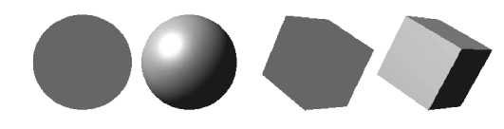
SHADING
Shading is important as a mechanism for conveying information about 3D shapes in 2D.
Representation of shapes with single colours render the images as 2D to our eyes.

Slide 11
LOCAL RENDERING OF LIGHT
Modelled in one of three ways.
Perfect specular reflection.
Light is reflected directionally.
Imperfect specular reflection.
Light is reflected imperfectly
Perfect diffuse reflection
Light is scattered in all directions.
These three models can be used to determine the shading of polygons.

Slide 12
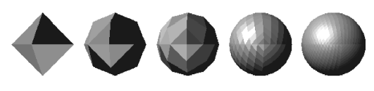
FLAT SHADING
Flat shading works by applying a single pixel colour across an entire polygon.
It cannot handle specular reflection.
Very quick and efficient, but realism is limited.
Especially for low polygon counts.
Separate polygons are clearly visible.

Slide 13
FLAT SHADING
The human eye is especially good at noticing edges.
Flat shading is thus acting against our biology.
Better results can be obtained by interpolation of shading across a polygon’s surface.
Common technique for this is Gouraud Shading.
Used when polygons are approximating curved surfaces.
This provides a linear colour gradient over the polygon.

Slide 14
GOURAUD SHADING
First, must calculate vertex intensity.
Simple method is to average the light intensity of all polygons sharing a vertex.
More complex method involves modelling light interaction at each vertex.
More computation, but more realistic output.
The arrows indicate
surface normals

Slide 15
GOURAUD SHADING
Light intensity at each vertex used to calculate light intensity of pixels in polygon.
10
10
5
15
10
2
17
10
20
0

Slide 16
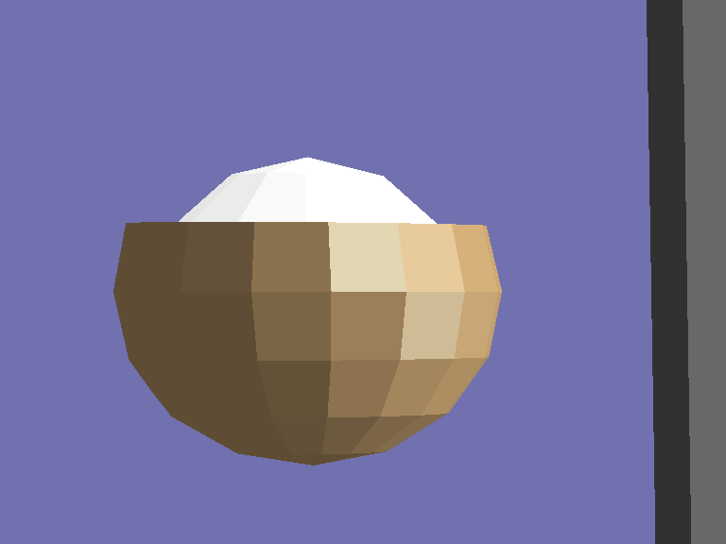
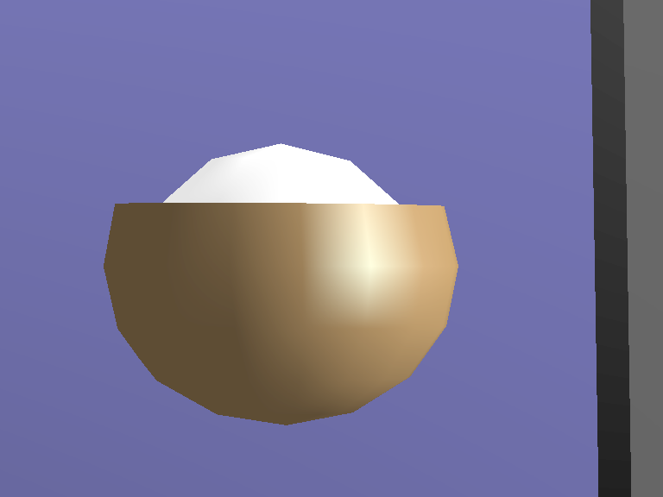
FLAT VERSUS GOURAUD
Flat Shading Model – note individual polygons easily identifiable.
Gouraud Shading Model – interpolation of pixel colours across polygons hides edges better.

Slide 17
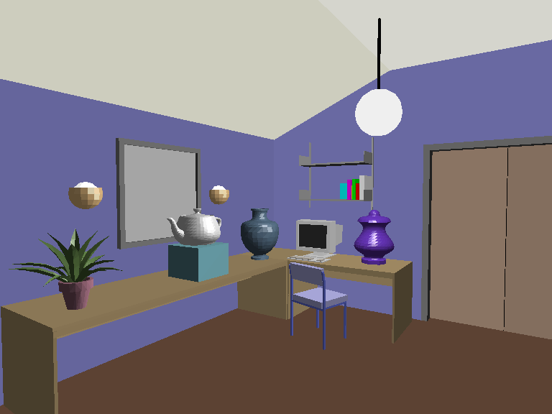
FLAT SHADING

Slide 18
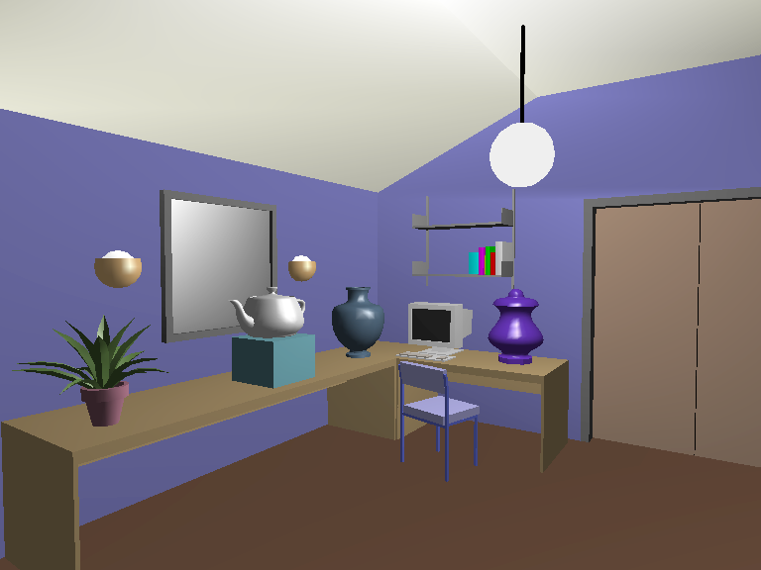
GOURAUD SHADING

Slide 19
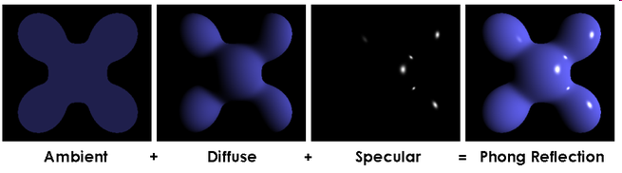
PHONG REFLECTION MODEL
The Phong Reflection Model works by estimating the colours of pixels.
Light described as the combination of:
Ambient light
Diffuse light
Specular Light

Slide 20
PHONG SHADING
Problem of visible edges mitigated by Gouraud shading
Not eliminated
Minimum and maximum intensity will always occur at vertexes.
Calculation works on the basis of interpolation.
Interpolation works slightly differently.

Slide 21
SURFACE NORMALS
When determining the way light interacts with a polygon, we base it on the surface normal.
A hypothetical line that extends perpendicularly from the point.
With flat shading, we base the intersection on the surface normal of the middle pixel of a polygon.
This gives a rough measure of light intensity.
With Gouraud, we base it on the intensity of each vertex.
More nuanced.

Slide 22
PHONG SHADING
Phong Shading interpolates the surface normals across a polygon.
Intensity is estimated based on these interpolated normals.
The arrows indicate
surface normals

Slide 23
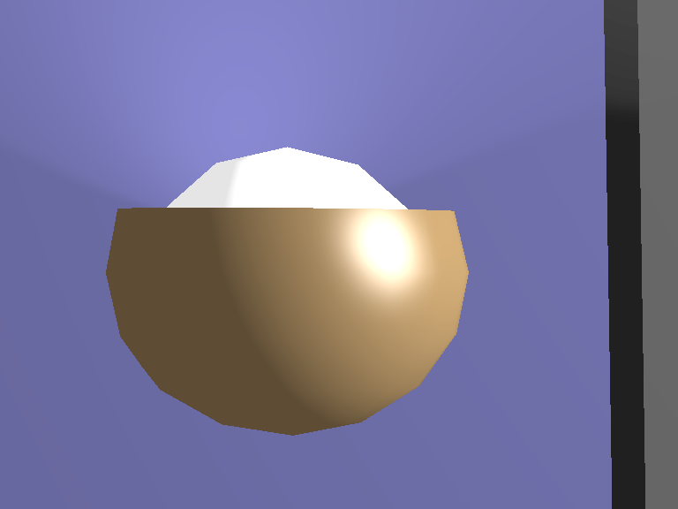
SHADING MODELS
Phong Shading
Flat Shading
Gouraud Shading

Slide 24
SPECULAR REFLECTION
Specular reflection can have its own colour.
A snooker ball’s highlight is the colour of the light, not the colour of the ball.
Several specular models exist
Phong
Basic, but good output
Cook-Tor
Optimised version of Phong, handles hardness
Blinn
Also handles softness of highlight
Toon
Simulates cartoon style shading
Play about with these in Blender.

